Slide 1
DAY 0

Slide 2
Programmer, Coder, Developer and Engineer
Programmer are those who writes program.
Coder is an unofficial way of saying Programmer.
Developers are the overall system developer who creates and knows a system end-to-end.
Engineer are the architecture designer.

Slide 3
CS / IT Fields
Software Engineer (web developer, mobile developer, desktop app developers)
Backend Developer
Frontend Developer
Web Designer (Figma, Adobe XD, HTML, CSS)
Full Stack Web Developer
DevOps (IaC)
Cloud Engineer (PaS= Platform as Service = Heroku, PythonAnywhere)
Machine Learning Engineer
Data Scientist
Network and Security Engineer
Ethical Hacker
Graphics Designer

Slide 4
Full Stack Developer
Backend + Frontend + Database + Cloud.
Has core strength on either FE or BE.

Slide 5
Backend Developer Road Map
Basic HTML, CSS, JS
Proficiency in any server-side scripting language (Python, JavaScript, Ruby, PHP etc., C#)
Proficiency in data structures and algorithms.
Proficiency in Web Frameworks (Django, NodeJS, RoR, Laravel, .net)
Proficiency in creating REST APIs (Application Programmable Interface).
Database Query Language (SQL, NoSQL)
Cloud Knowledge (AWS, EC2, S3, Lambda, Azure)
Web Server (Nginx, Apache)
DNS and Web Hosting
Docker

Slide 6
Frontend Developer Roadmap
Proficiency in HTML, CSS, SCSS, JS.
Proficiency in CSS frameworks (Material, Bootstrap).
Proficiency in data structures and algorithms.
Proficiency in any of the JS frameworks (Angular, React, Vue).
Consuming REST APIs.
Cloud Knowledge (AWS, Azure)
Web Server (Nginx, Apache)
DNS and Web Hosting
Docker

Slide 7
Data Scientist and ML Engineer Roadmap
Proficiency in a programming language (Python, R).
Proficiency in data structures and algorithms.
Proficiency in Linear Algebra, Calculus, Statistics and Probability.
Libraries like NumPy, Pandas, Matplotlib, Seaborn etc.
Data Wrangling; clean and structure data.
Proficiency in SQL.
ML Algorithms; Supervised and Unsupervised learnings (Linear Regression, K Means Clustering)
Data Modeling

Slide 8
Common Tools in a life of a Software Engineer
Git and GitHub (Version Control)
Trello, Jira Board
Slack, Skype, Teams
Docker

Slide 9
Some Server Side Scripting Languages
PHP (Laravel)
Python (Flask, Django, Pyramid, FastAPI)
JavaScript (NodeJS)
Ruby (Ruby on Rails)
C# (.net)
Rust (Rocket)

Slide 10
So Why to Choose Python?
It is easy to get started with programming using Python i.e. beginner friendly.
Very easy to create a prototype or an MVP or a POC.
It is a general purpose multi-paradigm language. You can direct your career to software engineer, data scientist or an ML engineer.
It is not the discussion that Python is a good language and PHP, C#, Rust are the bad languages.
Every languages has their own Pros and Cons.

Slide 11
Python and It's History
Python is a high-level interpreted language, designed by Guido Van Rossum.
It was first officially released in 1991.
It is a dynamically typed and garbage collected.
Python 2.0 was released on October 16, 2000.
On December 3, 2008, a backward incompatible version Python 3.0 was officially released.
The support for the Python 2.x version has been officially deceased by its creators since January 1, 2020

Slide 12
Python Slow or Fast ?

Slide 13
Is Python Slow?
Python execution time is comparatively slower than other compiled languages like C and C++.
The main reasons for this are; python being an interpreted language and a dynamically typed language.
Speed is compromised over flexibility.
But to what extent does it matter?
It matters in the fields where fast execution and limited resources are important factors. For example, in aero science.
Execution time is not significantly important for other general apps like educational apps, social media apps etc.

Slide 14
Top Companies Using Python
Uber
PayPal
NetFlix
Google
Facebook and many more
Source : https://brainstation.io/career-guides/who-uses-python-today

Slide 15
Companies Using Python in Nepal
Logpoint
FuseMachines
Janaki Technology (Khalti)
Aayulogic (Mero Job)
Programiz
Insight Workshop and many more

Slide 16
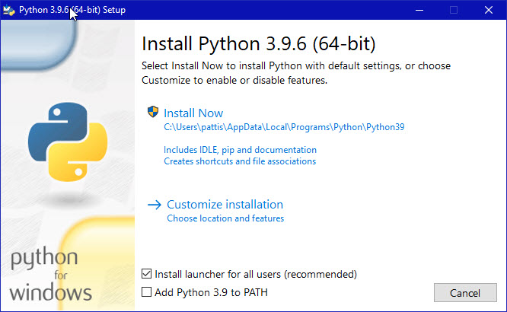
Python Installation

Slide 17
Let’s Solve Some Problems

Slide 18
Input a Number
Find if the number is odd or even

Slide 19
For the first 30 integers, print the number as it is as otherwise, “Fizz” if the number is a multiple of 3, “Buzz” if the number is a multiple of 5 and “FizzBuzz” if the number is the multiple of both 3 and 5.
Output
FizzBuzz …
1 …
2 14
Fizz FizzBuzz
4 16
Buzz …

Slide 20
A = 3
If remainder of A/3 and A/5 are 0 then FizzBuzz
Else if remainder of A/3 is 0 then Fizz
Else if A/5 0 then Buzz
Else A

Slide 21
N
If N is divided by 5 and 3
print FizzBuzz
If N is divided by 3
print Fizz
If N is divided by 5
print Buzz

Slide 22
Check whether an integer (not string) is palindrome or not.
Input: 123
Output: “Not Palindrome”
Input: 121
Output: “Palindrome”

Slide 23
Given an array of integers ‘nums’, find the integers which are at least repeated once.
input: [3, 4, 2, 2, 1, 3, 3, 3]
output: [3, 2]

Slide 24
Bonus Tips

Slide 25
How to be an efficient learner?
Professional Growth
Programming language is your weapon. Keep it sharpened.
Be proficient in Data Structure and Algorithms.
Be proficient in Design Patterns.
Do LeetCode Problems, Hackerrank.
Be active on GitHub and LinkedIn.
2-3 hours of deep work everyday (No distractions).
Master your IDE (Pycharm, VS code, Vim).

Slide 26
How to be an efficient learner?
Personal Growth
Have proper sleep and meal timing.
Don’t overwork to the point of burn out. Take rest in between work.
Go for a walk or jogging everyday.
Listen to podcast (Spotify, Google Podcast).
Make your English better. It will be useful to crack interviews.
Read Books.
Network with the people in the industry.
Be the leader, mentor, presentator or teacher whenever you get a platform.

Slide 27


Slide 28
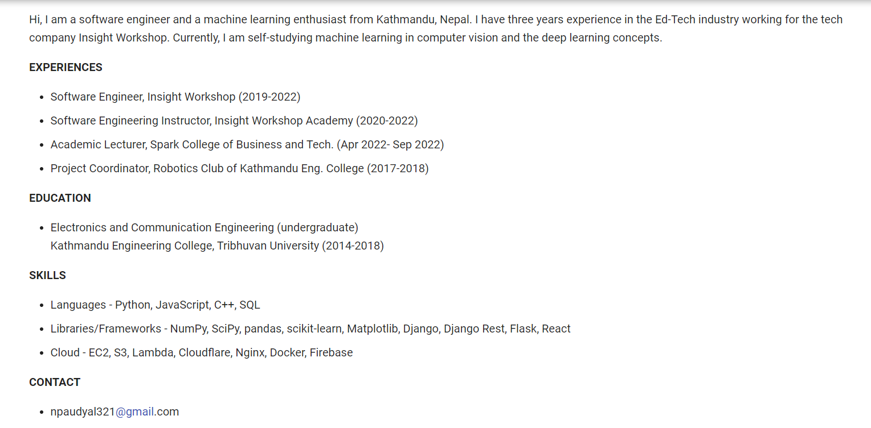

Nabin Paudyal
Python Developer

